Slide 1
Organized Mobile Data
Felix Huang

Slide 2
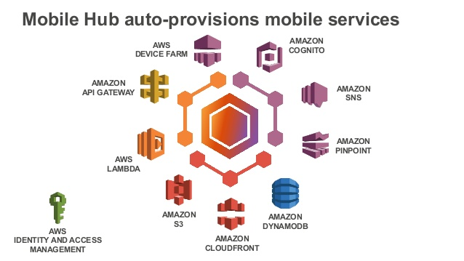

Slide 3
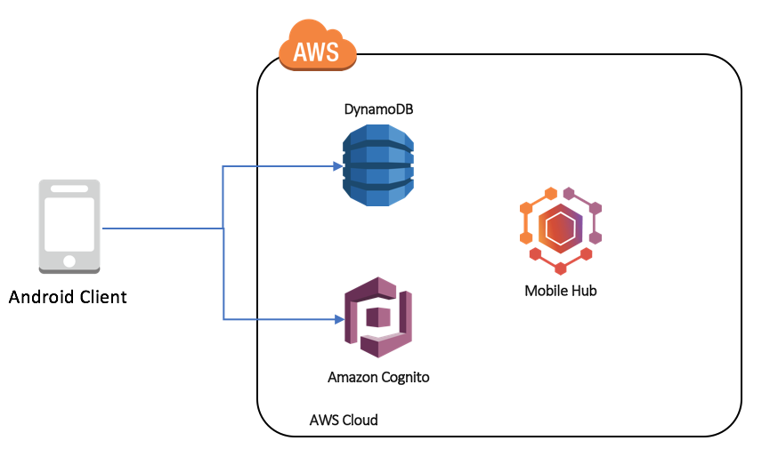

Slide 4

Capability Overview
Search articles on NewYorkTimes
Click on articles to view
Mobile Hub + Cognito + DynamoDB
Keep interesting articles in DynamoDB by clicking button in Android app
Query on DynamoDB from Android app

Slide 5
Search and Click
Find articles by keyword
In this example, articles from The New York Times
Select and view preferred article
For an interesting article a user tries to keep, or interruption occurs, the user clicks Keep button and it is saved on DynamoDB in AWS.

Slide 6

Keep Interesting Data – DynamoDB
Topics.topicIdx.put("trade war", 4);
Primary index
userId: primary key (hash key, user phone number)
noteId: sort key (“trade war”, 2)
Connect to DynamoDB
Suitable because high volume of small pieces of data
Stores data in DynamoDB at button press
userId, noteId, creationDate, content, title
Query on DynamoDB from Android App
userId = <phone number> and noteId begins with <topic>

Slide 7
Obstacles and Future Work
Topics.topicIdx.put("trade war", 4);
AWS Android SDK
Mobile Hub + Cognito (user, identity pool) + DynamoDB
Latest Android Studio may not work well with multiple *.jar
Not main thread
Mobile Hub + DynamoDB API requires it is another thread (async)
To develop display of collected articles, which supports deletion on DynamoDB
To explore and develop more options for user sign-up, sign-in
Cognito user pool and identity pool

